Slide 1



 | Department of Electronics and Telecommunication Engineering, NBA Accredited
Project:
Assistance bot using IR sensor for avoiding obstacle
Member:
Sania Bandekar(17201B0022)
Microproject: Embedded Systems

Slide 2
 | Introduction
The assistance bot acts as a obstacle avoider robot is used to defend itself against the threats that it may experience in the enviornment. The obstacle is detected by the IR sensors right in the front.The obstacle avoider bots are great when detection of threat is important.The obstacle avoider bots are great for military applications.Threat detection makes them capable enough to find the obstacle in front.The bot would detect the obstacle and change the direction of motion and movement.
Department of Electronics and Telecommunication Engineering, NBA Accredited
2

Slide 3
 | Applications
Defense
Threat avoiding bots
Tracking System.
Distance Measurement Purposes.
This can be used in automatic vacuum cleaning robots.
This can be used in assistance for blind people.
Department of Electronics and Telecommunication Engineering, NBA Accredited
5

Slide 4
 | Block Diagram
Battery (9v)
Assistance bot using IR sensor for avoiding obstacle
VoltageRegulator
IC 7805
Microcontroller
AT89S52
Port 0
Port 1
Port 2
Port3
Comparator IC LM324
Free to use
Free to use
Motor Driver IC L293d
IR Sensors
DC Motors
Department of Electronics and Telecommunication Engineering, NBA Accredited
3

Slide 5
 | Output
Department of Electronics and Telecommunication Engineering, NBA Accredited
5

Slide 6
 | Circuit diagram
Department of Electronics and Telecommunication Engineering, NBA Accredited
5

Slide 7
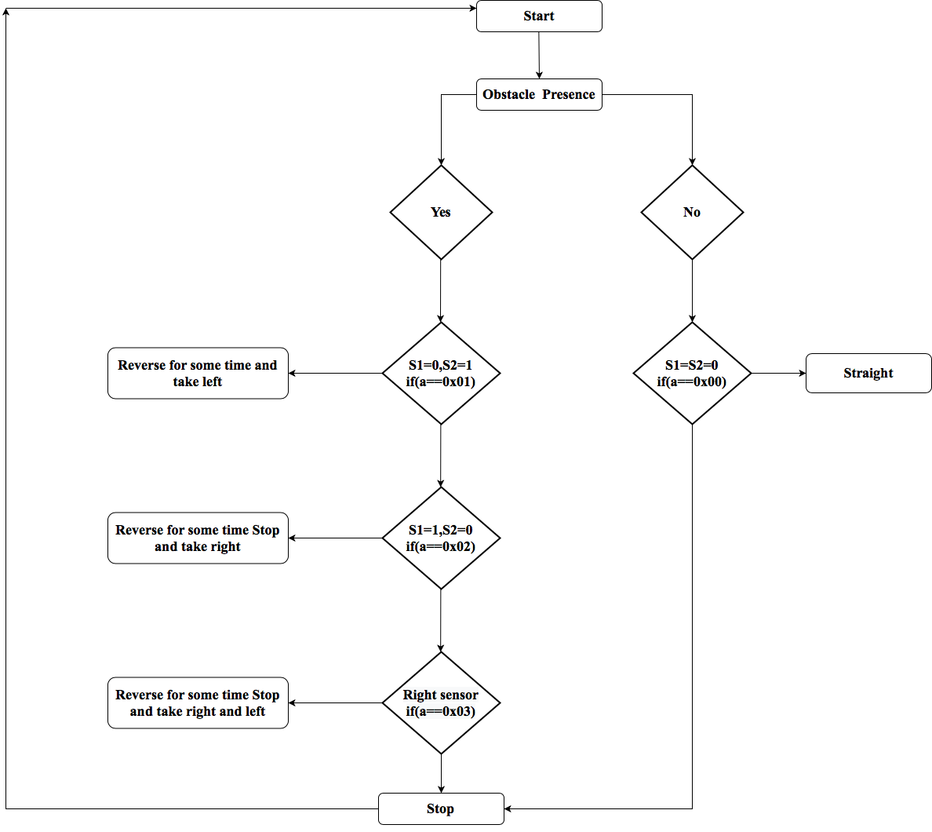
 | Flowchart & Algorithm
Start
If a==0x03meaning when obstacle is present at the front of both sensors(S1=1,S2=1), the robot should reverse for a while, stop then turn either left or right.The master vehicle will continue to follow the command and direction unless another input is detected by the sensors.
If a==0x01meaning when obstacle is present in the front of the right sensor(S1=0,S2=1), the robot should reverse for a while, stop and then turn left.The master will continue to follow the command and direction unless another input is detected by the sensors.
If a==0x02meaning when obstacle is present in the front of the left sensor(S1=1,S2=0), the robot should reverse for a while, stop and then turn right.The master will continue to follow the command and direction unless another input is detected by the sensors.
If a==0x00meaning when no obstacle is present in the front of both the sensors(S1=0,S2=0), the robot should continue moving straight.The master will continue to follow the command and direction unless another input is detected by the sensors.
Department of Electronics and Telecommunication Engineering, NBA Accredited
5

Slide 8

 | Program
Department of Electronics and Telecommunication Engineering, NBA Accredited
5

Slide 9

 | Program
Department of Electronics and Telecommunication Engineering, NBA Accredited
5

Slide 10

 | Program
Department of Electronics and Telecommunication Engineering, NBA Accredited
5

Slide 11
 | Simulation
Department of Electronics and Telecommunication Engineering, NBA Accredited
5

